Slide 1
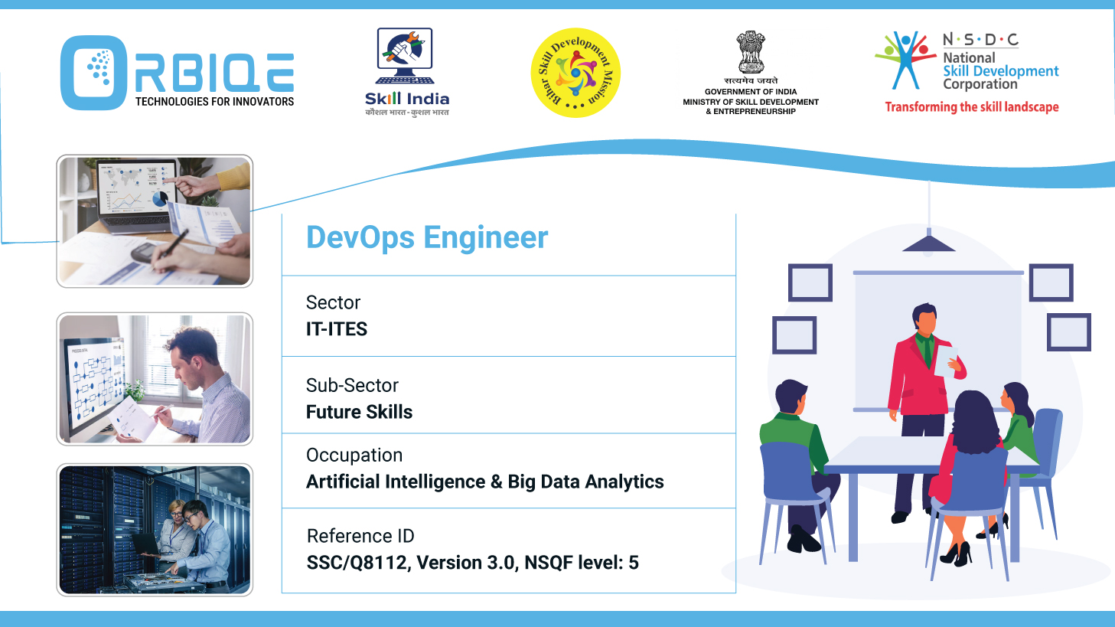
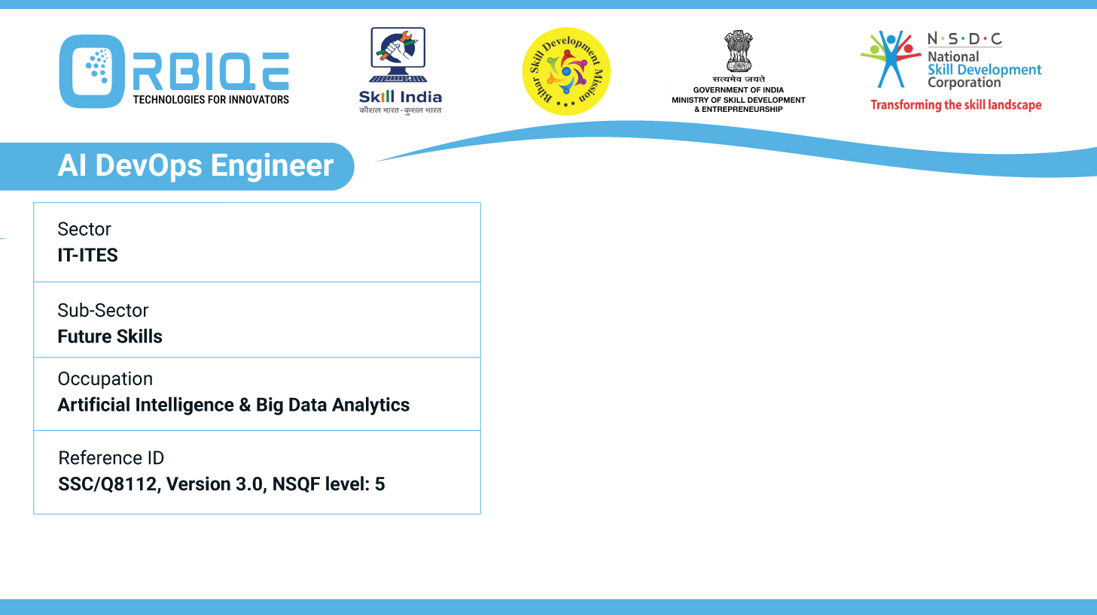
Name- Krishna Kant Dubey

Slide 2

Different automation techniques and procedures, exploring opportunities for streamlining tasks in AI Database Maintenance

Slide 3
Agenda
Self-Healing Databases
AI-Powered Monitoring & Alerting
Automated Query Optimization
Predictive Maintenance
Automated Backup and Recovery
Security Automation
Python-Based Automation Frameworks

Slide 4
Self-Healing Databases
Functionality: Automatically detect and resolve issues like performance bottlenecks, data inconsistencies, and hardware failures.
Techniques:
Machine learning models for anomaly detection.
Predictive analytics to forecast failures.
Reinforcement learning for dynamic optimization.
Benefits: Reduced downtime, lower operational costs, and improved fault tolerance

Slide 5
AI-Powered Monitoring & Alerting
Tools: Prometheus with ML plugins, ELK stack with anomaly detection, Azure Monitor with AI insights.
Capabilities:
Real-time performance tracking.
Automated alerts for unusual patterns.
Root cause analysis using AI models.
Benefits: Proactive issue resolution and reduced manual oversight

Slide 6
Automated Query Optimization
Approach: AI analyzes query patterns and rewrites inefficient queries.
Tools: AI2SQL, Oracle Autonomous Database.
Benefits: Faster response times and reduced resource consumption

Slide 7
Predictive Maintenance
Technique: Use historical data and ML models to anticipate when maintenance is needed.
Use Cases:
Index rebuilding.
Storage reallocation.
Hardware replacement scheduling.
Benefits: Avoids reactive fixes and improves system uptime

Slide 8
Automated Backup and Recovery
AI Role:
Determines optimal backup schedules based on usage patterns.
Validates backup integrity.
Initiates recovery procedures autonomously.
Tools: AWS Backup with ML, Azure Site Recovery.

Slide 9
Security Automation
Capabilities:
AI-driven threat detection and response.
Automated role and permission audits.
Encryption key rotation and access pattern analysis.
Tools: IBM Guardium, Microsoft Defender for Cloud

Slide 10
Python-Based Automation Frameworks
Libraries: SQLAlchemy, PyMongo, pandas, schedule, airflow
Use Cases:
Automating ETL workflows.
Scheduling maintenance tasks.
Integrating AI monitoring tools.

Slide 11
Thank You

